Slide 1
Trees

Slide 2
Trees
A tree is recursively defined as a set of one or more nodes where one node is designated as the root of the tree and all the remaining nodes can be partitioned into non-empty sets each of which is a sub-tree of the root.

Slide 3
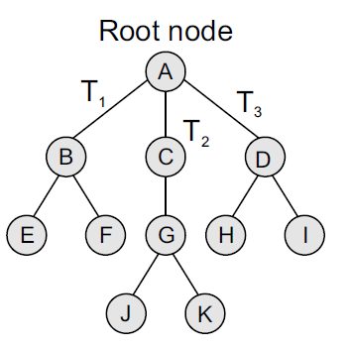
Basic terminology
Root node : The root node R is the topmost node in the tree. If R = NULL, then it means the tree is empty.
Leaf node : A node that has no children is called the leaf node or the terminal node.
Degree: Degree of a node is equal to the number of children that a node has The degree of a leaf node is zero.

Slide 4
Height and Depth of Tree
Height of a tree : It is the total number of nodes on the path from the root node to the deepest node in the tree. A tree with only a root node has a height of 1.
Depth : The depth of a node N is given as the length of the path from the root R to the node N. The depth of the root node is zero.

Slide 5
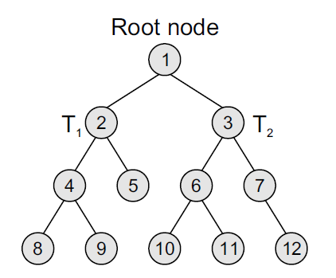
Binary Tree
A binary tree is a data structure that is defined as a collection of elements called nodes. In a binary tree, the topmost element is called the root node, and each node has 0, 1, or at the most 2 children.

Slide 6
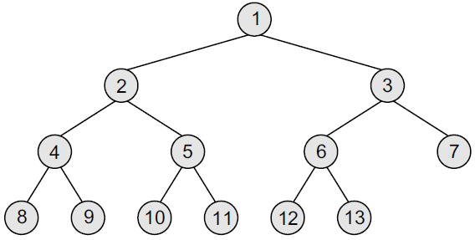
Complete binary tree
A complete binary tree is a binary tree that satisfies two properties.
First, in a complete binary tree, every level, except possibly the last, is completely filled.
Second, all nodes appear as far left as possible.

Slide 7
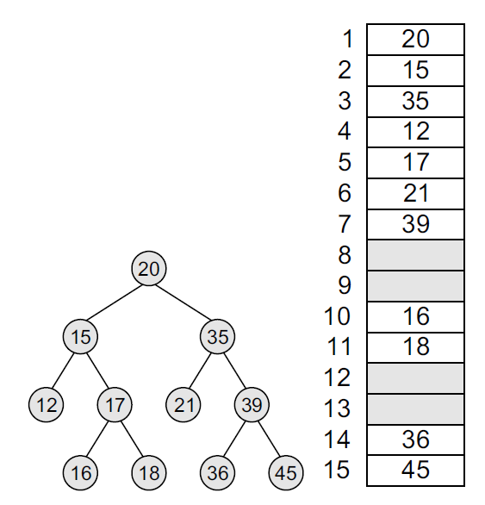
Array representation of binary tree
The root of the tree will be stored in the first location. That is, TREE[1] will store the data of the root element.
The children of a node stored in location K will be stored in locations (2 × K) and (2 × K+1).

Slide 8
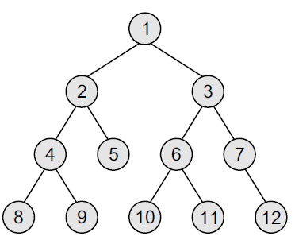
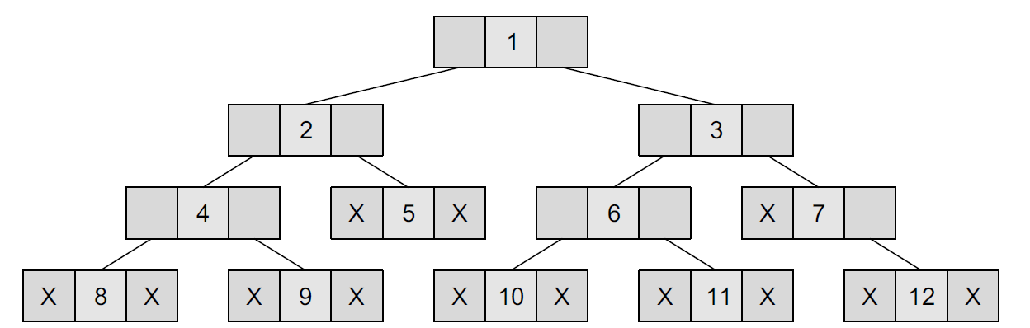
Linked list representation of binary tree

Slide 9
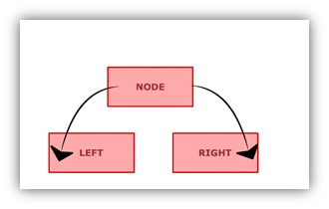
Node representation in Python
class Node:
""" Class Node """
def __init__(self, value):
self.left = None
self.data = value
self.right = None

Slide 10
Traversing a Binary Tree
Traversing a binary tree is the process of visiting each node in the tree exactly once in a systematic way.
Inorder traversal
Preorder traversal
Postorder traversal

Slide 11
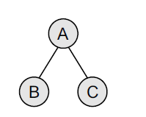
In-order Traversal
To traverse a non-empty binary tree in in-order, the following operations are performed recursively at
each node. The algorithm works by:
1. Traversing the left sub-tree
2. Visiting the root node
3. Traversing the right sub-tree.

Slide 12
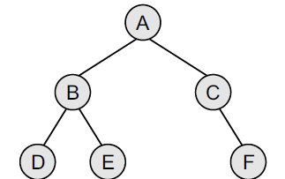
Find in-order traversal

Slide 13
Pre-order traversal
To traverse a non-empty binary tree in pre-order, the following operations are performed recursively at each node.
The algorithm works by:
1. Visiting the root node,
2. Traversing the left sub-tree, and finally
3. Traversing the right sub-tree.

Slide 14
Find pre-order traversal

Slide 15
Post-order traversal
To traverse a non-empty binary tree in post-order, the following operations are performed recursively at each node.
The algorithm works by:
1. Traversing the left sub-tree,
2. Traversing the right sub-tree, and finally
3. Visiting the root node.

Slide 16
Find post-order traversal

Slide 17
Implementing Binary tree traversals
class Node:
def __init__(self, key):
self.left = None
self.right = None
self.val = key

Slide 18
In-order traversal
def printInorder(root):
if root:
printInorder(root.left)
print(root.val)
printInorder(root.right)

Slide 19
Pre-order traversal
def printPreorder(root):
if root:
print(root.val)
printPreorder(root.left)
printPreorder(root.right)

Slide 20
Post-order traversal
def printPostorder(root):
if root:
printPostorder(root.left)
printPostorder(root.right)
print(root.val)

Slide 21
Creating Binary Tree
root = Node(1)
root.left = Node(2)
root.right = Node(3)
root.left.left = Node(4)
root.left.right = Node(5)
print ("Preorder traversal of binary tree is“)
printPreorder(root)
print ("\nInorder traversal of binary tree is“)
printInorder(root)
print ("\nPostorder traversal of binary tree is“)
printPostorder(root)

Slide 22
Thank You

